Slide 1
SESSIONS 1 AND 2
INTRODUCTION TO HRM

Slide 2
Human Resource Management at Work
  What Is Human Resource Management (HRM)?
    The process of acquiring, training, appraising, and compensating employees, and of attending to their labor relations, health and safety, and fairness concerns.
  Organization
    People with formally assigned roles who work together to achieve the organization’s goals.
  Manager
    The person responsible for accomplishing the organization’s goals, and who does so by managing the efforts of the organization’s people.
Copyright © 2011 Pearson Education, Inc. publishing as Prentice Hall
1–2
Notes:
Human resource management is the process of acquiring, training, appraising, and compensating employees, and of attending to their labor relations, health and safety, and fairness concerns.

Slide 3
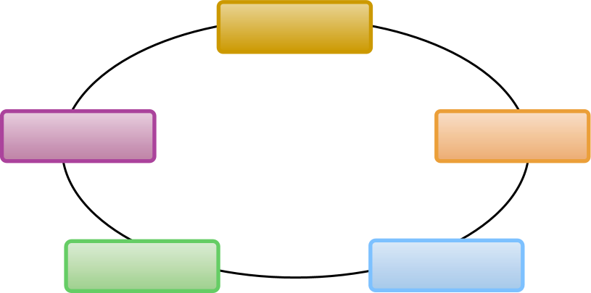
The Management Process
Planning
Controlling
Organizing
Leading
Staffing
Copyright © 2011 Pearson Education, Inc. publishing as Prentice Hall
1–3
Notes:
Most experts agree that managing involves five functions: planning, organizing, staffing, leading, and controlling. In total, these functions represent the management process.

Slide 4

Human Resource Management Processes
Acquisition
Fairness
Training
Human Resource Management (HRM)
Health and Safety
Appraisal
Labor Relations
Compensation
Copyright © 2011 Pearson Education, Inc. publishing as Prentice Hall
1–4
Notes:
HRM involves several processes. The topics we’ll discuss will provide you with concepts and techniques needed to perform the “people” or personnel aspects of your job as a manager.

Slide 5
Personnel Aspects of a Manager’s Job
  Conducting job analyses
  Planning labor needs and recruiting job candidates
  Selecting job candidates
  Orienting and training new employees
  Managing wages and salaries
  Providing incentives and benefits
  Appraising performance
  Communicating
  Training and developing managers
  Building employee commitment
Copyright © 2011 Pearson Education, Inc. publishing as Prentice Hall
1–5
Notes:
Managers are involved daily with many of the personnel aspects of HRM in accomplishing the organization’s goals, and managing the efforts of the organization’s people.

Slide 6
Personnel Mistakes
  Hire the wrong person for the job
  Experience high turnover
  Have your people not doing their best
  Waste time with useless interviews
  Have your firm in court because of discriminatory actions
  Have your firm cited by OSHA for unsafe practices
  Have some employees think their salaries are unfair and inequitable relative to others in the organization
  Allow a lack of training to undermine your department’s effectiveness
  Commit any unfair labor practices
Copyright © 2011 Pearson Education, Inc. publishing as Prentice Hall
1–6
Notes:
Why are the concepts and techniques of HRM important to all managers? Perhaps it’s easier to answer this by listing some of the personnel mistakes you don’t want to make while managing.
Carefully studying this book will help you avoid mistakes like these.

Slide 7

Basic HR Concepts
  The bottom line of managing:
  Getting results
  HR creates value by engaging in activities that produce the employee behaviors that the organization needs to achieve its strategic goals.
  Looking ahead: Using evidence-based HRM to measure the value of HR activities in achieving those goals.
Copyright © 2011 Pearson Education, Inc. publishing as Prentice Hall
1–7
Notes:
Hiring the right people for the right jobs and motivating, appraising, and developing them will likely get the results you are seeking. Remember that success comes through people.

Slide 8

Line and Staff Aspects of HRM
  Line Manager
    Is authorized (has line authority) to direct the work of subordinates and is responsible for accomplishing the organization’s tasks.
  Staff Manager
    Assists and advises line managers.
    Has functional authority to coordinate personnel activities and enforce organization policies.
Copyright © 2011 Pearson Education, Inc. publishing as Prentice Hall
1–8
Notes:
Line managers manage operational functions that are crucial for the company’s survival. Staff managers run departments that are advisory or supportive, like purchasing, HRM, and quality control.
Human resource managers are usually staff managers. They assist and advise line managers with recruiting, hiring, and compensation. However, line managers still have human resource duties.

Slide 9
Line Managers’ HRM Responsibilities
  Placing the right person on the right job
  Starting new employees in the organization (orientation)
  Training employees for jobs that are new to them
  Improving the job performance of each person
  Gaining creative cooperation and developing smooth working relationships
  Interpreting the firm’s policies and procedures
  Controlling labor costs
  Developing the abilities of each person
  Creating and maintaining department morale
  Protecting employees’ health and physical condition
Copyright © 2011 Pearson Education, Inc. publishing as Prentice Hall
1–9
Notes:
In small organizations, line managers carry out many personnel duties unassisted. As the organization grows, the need arises for the specialized assistance, knowledge, and advice of a human resource department.

Slide 10
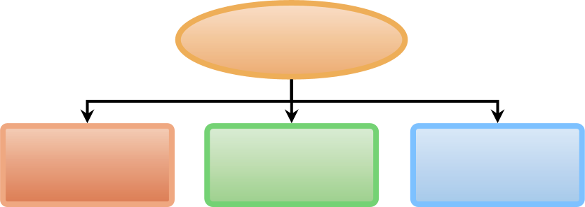
Human Resource Managers’ Duties
Functions of
HR Managers
Line Function
Line Authority
Implied Authority
Coordinative
Function
Functional Authority
Staff Functions
Staff Authority
Innovator/Advocacy
Copyright © 2011 Pearson Education, Inc. publishing as Prentice Hall
1–10
Notes:
An HR manager directs the activities of the people in the HR department, coordinates organizational-wide personnel activities and provides HRM assistance and advice to line managers.

Slide 11
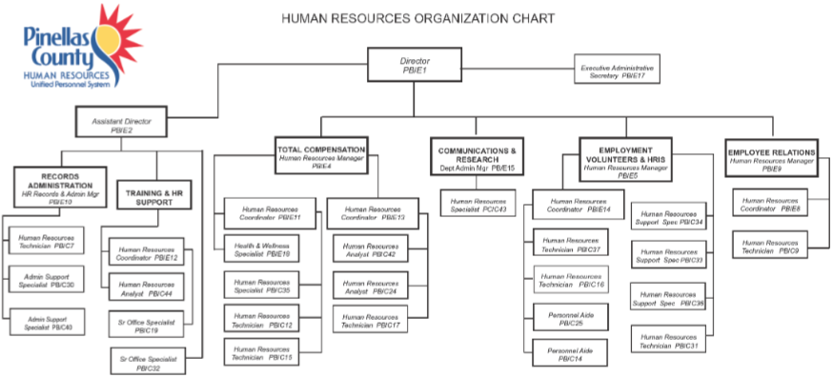
FIGURE 1–1 Human Resources Organization Chart for a Large Organization
Copyright © 2011 Pearson Education, Inc. publishing as Prentice Hall
1–11
Notes:
The size of the human resource department reflects the size of the employer. For a very large employer, an organization chart like the one in Figure 1-1 would be typical, containing a full complement of specialists for each HR function.

Slide 12
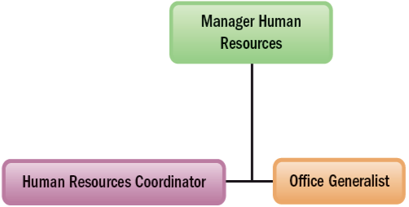
FIGURE 1–2 Human Resources Organization Chart for a Small Company
Copyright © 2011 Pearson Education, Inc. publishing as Prentice Hall
1–12
Notes:
The HR team for a small firm may contain just five or six (or fewer) staff, and have an organization similar to that in Figure 1-2. There is generally about one human resource employee per 100 company employees.

Slide 13
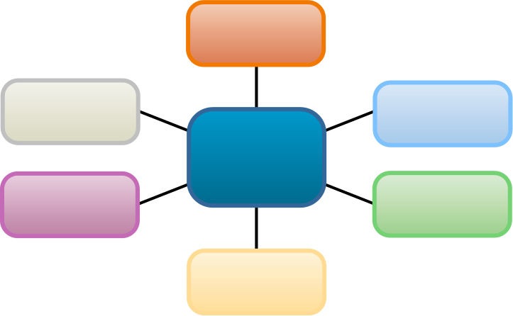
Human Resource Specialties
Recruiter
Labor relations specialist
EEO coordinator
Human Resource Specialties
Training specialist
Job analyst
Compensation manager
Copyright © 2011 Pearson Education, Inc. publishing as Prentice Hall
1–13
Notes:
• Recruiters search for qualified job applicants.
• Equal employment opportunity (EEO) coordinators investigate and resolve EEO grievances; examine organizational practices for potential violations; and compile and submit EEO reports.
• Job analysts collect and examine information about jobs to prepare job descriptions.
• Compensation managers develop compensation plans and handle the employee benefits program.
• Training specialists plan, organize, and direct training activities.
• Labor relations specialists advise management on all aspects of union–management relations.

Slide 14
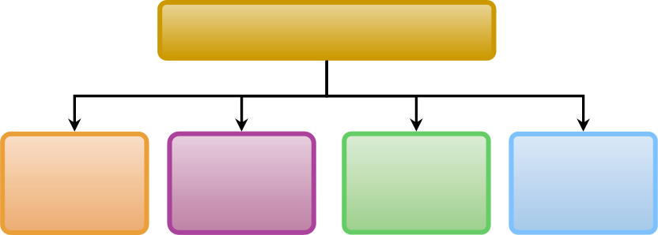
New Approaches to Organizing HR
New HR Services Groups
Transactional HR group
Corporate
HR group
Embedded
HR unit
Centers of Expertise
Copyright © 2011 Pearson Education, Inc. publishing as Prentice Hall
1–14
Notes:
Employers are experimenting with offering HR services in new ways. For example, some employers organize their HR services around four groups: transactional, corporate, embedded, and centers of expertise.

Slide 15
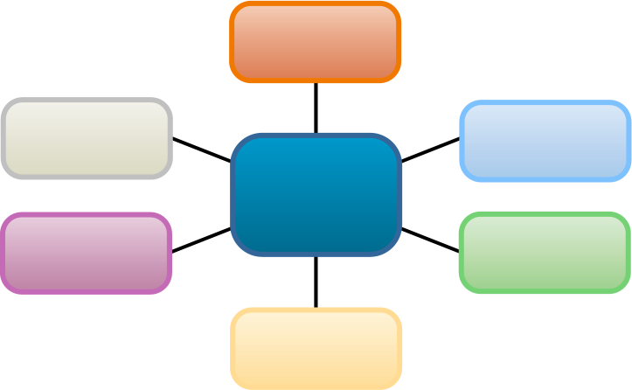
Trends Shaping Human Resource Management
Globalization
and Competition Trends
Indebtedness (“Leverage”) and Deregulation
Technological Trends
Trends in HR Management
Trends in the Nature of Work
Workforce and Demographic Trends
Economic Challenges and Trends
Copyright © 2011 Pearson Education, Inc. publishing as Prentice Hall
1–15
Notes:
Some trends shaping human resource management practices include globalization, technology, deregulation, debt or “leverage,” changes in demographics and the nature of work, and economic challenges.

Slide 16
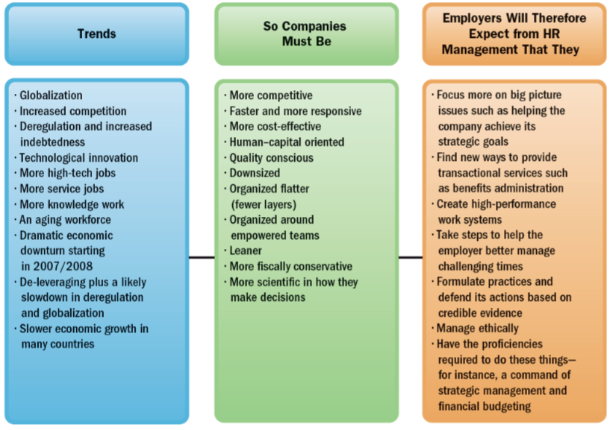
FIGURE 1–4 Trends Shaping Human Resource Management
Copyright © 2011 Pearson Education, Inc. publishing as Prentice Hall
1–16
Notes:
Trends shaping HRM are summarized in Figure 1-4.

Slide 17
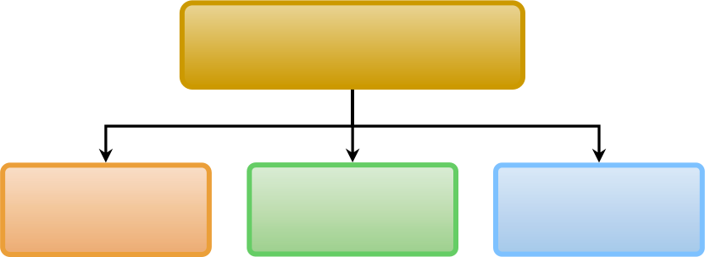
Trends in the Nature of Work
Changes in How We Work
High-Tech
Jobs
Service
Jobs
Knowledge Work and Human Capital
Copyright © 2011 Pearson Education, Inc. publishing as Prentice Hall
1–17
Notes:
Technology has also had a huge impact on how people work, and on the skills and training today’s workers need. Jobs are becoming more high tech, less-labor intensive, and require more knowledge and higher skill levels (human capital).

Slide 18

Workforce and Demographic Trends
Demographic Trends
Generation “Y”
Trends Affecting Human Resources
Retirees
Nontraditional Workers
Copyright © 2011 Pearson Education, Inc. publishing as Prentice Hall
1–18
Notes:
Demographic trends are making finding, hiring, and supervising employees more challenging.

Slide 19
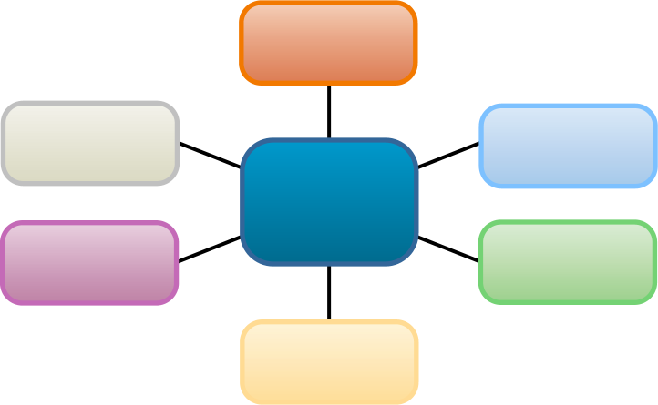
Important Trends in HRM
The New HR Managers
Strategic
HRM
High-Performance Work Systems
Human Resource Management Trends
Evidence-Based HRM
Managing
Ethics
HR
Certification
Copyright © 2011 Pearson Education, Inc. publishing as Prentice Hall
1–19
Notes:
Trends like these translate into changes in HRM practices, and in what employers expect from their human resource managers.

Slide 20
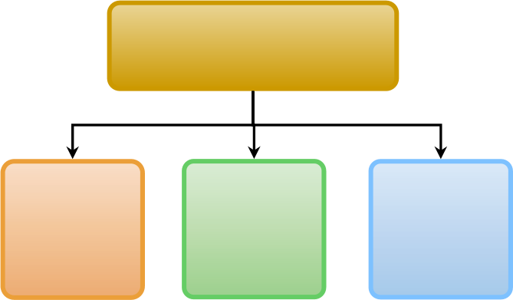
Meeting Today’s HRM Challenges
The New Human Resource Managers
Find new ways to provide transactional services
Acquire broader business knowledge and new HRM proficiencies
Focus more on “big picture” (strategic) issues
Copyright © 2011 Pearson Education, Inc. publishing as Prentice Hall
1–20
Notes:
HR managers can play big roles in strategic planning and management by helping the top managers in devising functional and departmental plans that support the organization’s overall strategic plan, and then assisting in execution of the plans.

Slide 21

TABLE 1–2 Some Technological Applications to Support HR
Technology
How Used by HR
Application service providers (ASPs) and technology outsourcing
ASPs provide software application, for instance, for processing employment applications. The ASPs host and manage the services for the employer from their own remote computers
Web portals
Employers use these, for instance, to enable employees to sign up for and manage their own benefits packages and to update their personal information
Streaming desktop video
Used, for instance, to facilitate distance learning and training or to provide corporate information to employees quickly and inexpensively
Internet- and network-monitoring software
Used to track employees’ Internet and e-mail activities or to monitor their performance
Electronic signatures
Legally valid e-signatures that employers use to more expeditiously obtain signatures for applications and record keeping
Electronic bill presentment
and payment
Used, for instance, to eliminate paper checks and to facilitate payments to employees and suppliers
Data warehouses and computerized analytical programs
Help HR managers monitor their HR systems. For example, they make it easier to assess things like cost per hire, and to compare current employees’ skills with the firm’s projected strategic needs
Copyright © 2011 Pearson Education, Inc. publishing as Prentice Hall
1–21
Notes:
Table 1-2 lists some important ways employers use technology to support their HRM activities.

Slide 22

High-Performance Work Systems
  Increase productivity and performance by:
    Recruiting, screening and hiring more effectively
    Providing more and better training
    Paying higher wages
    Providing a safer work environment
    Linking pay to performance
Copyright © 2011 Pearson Education, Inc. publishing as Prentice Hall
1–22
Notes:
A high-performance work system is a set of HRM policies and practices that together produce superior employee performance.

Slide 23
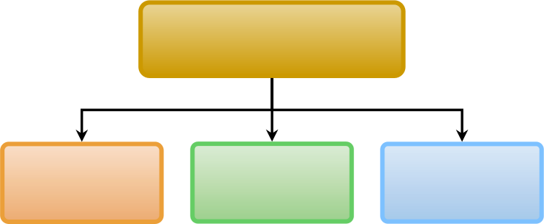
Evidence-Based HRM
Providing Evidence for HRM Decision Making
Actual measurements
Existing
data
Research
studies
Copyright © 2011 Pearson Education, Inc. publishing as Prentice Hall
1–23
Notes:
Evidence-based HRM is the deliberate use of the best-available evidence in making decisions about the human resource management practices you are focusing on.

Slide 24

Managing Ethics
  Ethics
    Standards that someone uses to decide what his or her conduct should be
  HRM-related Ethical Issues
    Workplace safety
    Security of employee records
    Employee theft
    Affirmative action
    Comparable work
    Employee privacy rights
Copyright © 2011 Pearson Education, Inc. publishing as Prentice Hall
1–24
Notes:
Every line manager or human resource manager needs to keep in mind the ethical implications of his or her employee-related decisions.

Slide 25

HR Certification
  HR is becoming more professionalized.
  Society for Human Resource Management (SHRM)
    SHRM’s Human Resource Certification Institute (HRCI)
      SPHR (Senior Professional in HR) certificate
      GPHR (Global Professional in HR) certificate
      PHR (Professional in HR) certificate
Copyright © 2011 Pearson Education, Inc. publishing as Prentice Hall
1–25
Notes:
As the human resource manager’s job becomes more demanding, HRM is becoming more professionalized. The Society for Human Resource Management’s (SHRM) HR professional certification exams test the HR professional’s knowledge of all aspects of HRM.

Slide 26
K E Y T E R M S
organization
manager
management process
human resource management (HRM)
authority
line authority
staff authority
line manager
staff manager
functional authority
globalization
human capital
Copyright © 2011 Pearson Education, Inc. publishing as Prentice Hall
1–26

Slide 27
Why Strategic Planning Is Important
To All Managers
  The firm’s strategic plan guides much of what is done by all to accomplish organizational goals.
  Decisions made by managers depend on the goals set at each organizational level in support of higher level goals.
Copyright © 2011 Pearson Education, Inc. publishing as Prentice Hall
3–27
Notes:
The Importance of Strategic Planning
You may not realize it when you’re managing, but your firm’s strategic plan is guiding much of what you do.
Management expert Peter Drucker once said that management “. . . is the responsibility for execution.” Managers are judged by the extent to which you accomplish your unit’s goals.
Those aims or goals—and the hard work you put into accomplishing them—all depend on your firm’s plans for the future.

Slide 28
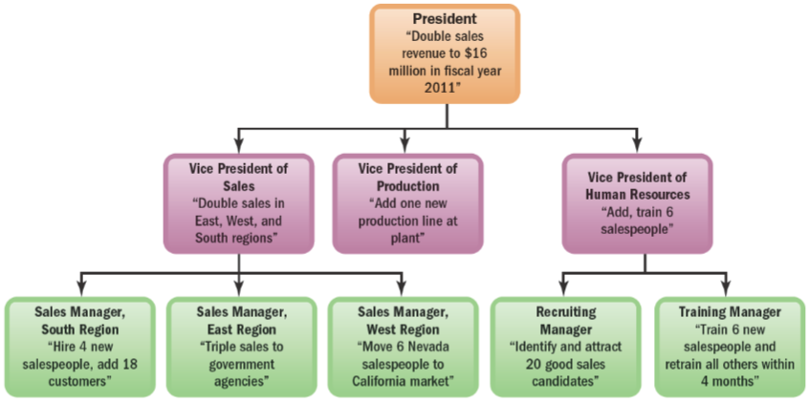
FIGURE 3–1 Sample Hierarchy of Goals Diagram for a Company
Copyright © 2011 Pearson Education, Inc. publishing as Prentice Hall
3–28
Notes:
The Hierarchy of Goals
In well-run companies, the goals from the top of the organization down to where you’re working should form an unbroken chain (or “hierarchy”) of goals.
The hierarchy of goals diagram in Figure 3-1 summarizes this. At the top of the company, the president and his or her staff set strategic goals. Lower-level managers (in this case, vice presidents) then set goals (such as “Add one production line at Plant A”).
Without a clear plan at the top, no one in the company would have the foggiest notion of what to do. At best, you’d all be working at cross-purposes.

Slide 29
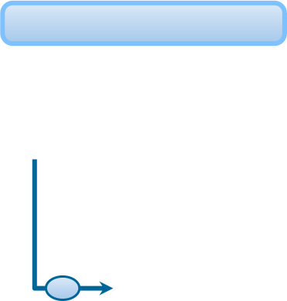




Fundamentals of Management Planning
The Planning Process
1
Set an objective.
2
Make forecasts and check assumptions.
3
Determine/develop alternative courses of action.
4
Evaluate the alternatives.
5
Implement and evaluate your plan.
Copyright © 2011 Pearson Education, Inc. publishing as Prentice Hall
3–29
Notes:
The Planning Process
People make plans every day, often without giving it a thought. We plan our routes to school, what courses to take, and what to do on Saturday night. Underlying all those plans, however, is an often unstated planning process. Once implemented, plans must be evaluated to see if they must be revised to better fit changing competitive conditions.

Slide 30
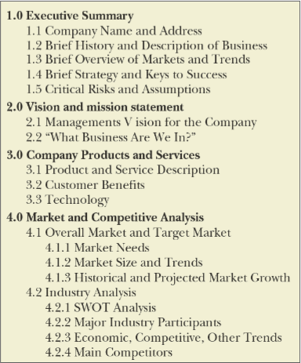
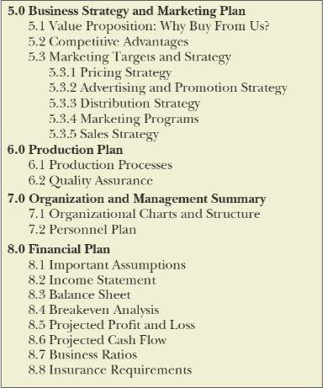
FIGURE 3–2 Business Plan Table of Contents
Copyright © 2011 Pearson Education, Inc. publishing as Prentice Hall
3–30
Notes:
Putting Together the Business Plan
The business plan provides a comprehensive view of the firm’s situation today and of its company-wide and departmental goals and plans for the next 3 to 5 years. Larger firms label their plans “strategic plans.”
There are no rigid rules regarding what such plans must contain. However, they usually include, at a minimum, (1) a description of the business (including ownership and products or services), (2) the marketing plan, (3) the financial plan, and (4) the management and/or personnel plan. Figure 3-2 displays the contents of a typical business plan.

Slide 31
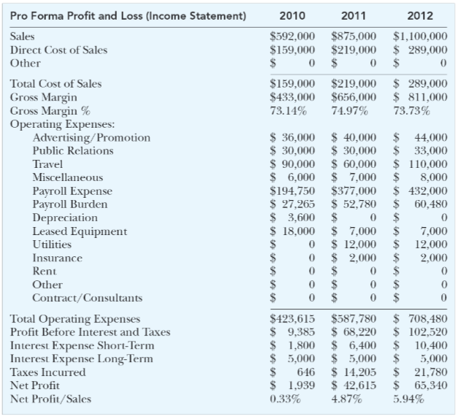
FIGURE 3–3 Acme Consulting Profit and Loss
Copyright © 2011 Pearson Education, Inc. publishing as Prentice Hall
3–31
Notes:
The Financial Plan
“What’s the bottom line?” is the first question managers and bankers ask most. Plans, goals, and accomplishments end up expressed in financial terms.
The financial plan in Figure 3-3 is a projected (or “pro forma” or planned) profit and loss (P&L) statement showing the revenue, cost, and profit (or loss) implications of a company’s marketing, production, and personnel plans. The pro forma P&L predicts that, if plans work out as anticipated, these are the revenues, costs, and profits or losses the firm should produce. It shows the expected bottom line.

Slide 32










How Managers Set Objectives:
SMART Goals
S
Specific
M
Measureable
A
Attainable
R
Relevant
T
Timely
Copyright © 2011 Pearson Education, Inc. publishing as Prentice Hall
3–32
Notes:
Setting SMART Goals
Setting effective goals is an essential management skill. Experienced managers have a simple and effective way to check whether their goals are good or not—they use the acronym “SMART.”
Good goals are specific (make clear what to achieve), measurable, attainable; relevant (in terms of what you’re setting the goal for), and timely (they have deadlines and milestones).

Slide 33
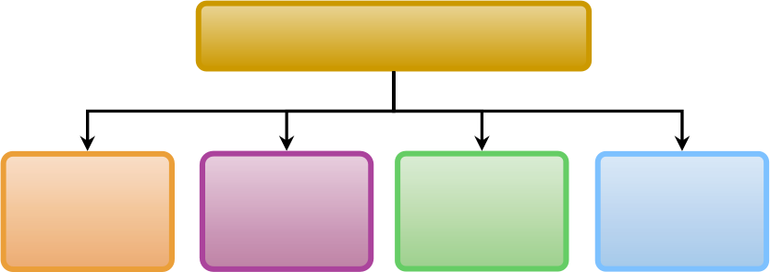
How to Set Motivational Goals
Motivational Goal Setting
Assign
specific
goals
Assign measurable goals
Assign challenging but doable goals
Encourage employee participation
Copyright © 2011 Pearson Education, Inc. publishing as Prentice Hall
3–33

Slide 34





Using Management by Objectives (MBO)
The MBO Process
1
Set overall organizational goals.
2
Set departmental (supporting) goals.
3
Discuss departmental goals with subordinates.
4
Set individual goals and timetables.
5
Give feedback on progress toward goal.
Copyright © 2011 Pearson Education, Inc. publishing as Prentice Hall
3–34
Notes:
Management by Objectives (MBO)
The supervisor and subordinate jointly set goals for the latter and periodically assess progress toward those goals.
MBO has benefits. It provides a simple process for working through how the goals at each level will relate to those above and to those below. It also capitalizes on the advantages of employee participation.
The downside is that MBO is time consuming. These programs often involve numerous meetings among employees and supervisors, and then extensively documenting each person’s goals in various electronic or hard-copy formats. All that takes time.

Slide 35
The Strategic Management Process
  Strategy
    A course of action the organization intends to pursue to achieve its strategic aims.
  Strategic Plan
    How an organization intends to match its internal strengths and weaknesses with its external opportunities and threats to maintain a competitive advantage over the long term.
  Strategic Management
    The process of identifying and executing the organization’s mission by matching its capabilities with the demands of its environment.
  Leveraging
    Capitalizing on a firm’s unique competitive strength while underplaying its weaknesses.
Copyright © 2011 Pearson Education, Inc. publishing as Prentice Hall
3–35
Notes:
In practice, determining what the organization’s long-term, overall plan should be requires some special tools. For example, you need to be able to systematically review the competitive landscape and analyze what your best strategic, long-term courses of action might be. Strategic planning, which we turn to now, provides these special tools. We’ll start with some definitions.

Slide 36
Business Vision and Mission
  Vision
    A general statement of an organization’s intended direction that evokes emotional feelings in organization members.
  Mission
    Spells out who the firm is, what it does, and where it’s headed.
Copyright © 2011 Pearson Education, Inc. publishing as Prentice Hall
3–36
Notes:
Managers sometimes formulate a vision statement to summarize how they see the essence of their business down the road. The vision statement is a general statement of the firm’s intended direction and shows, in broad terms, “what we want to become.”
Whereas vision statements usually describe in broad terms what the business should be, the firm’s mission statement summarizes its answer to the question, “What business are we in?”
Managers often use the mission statement to pinpoint whether and how the firm will vertically integrate, as well as the firm’s product scope (diversity), geographic coverage, and competitive advantage.

Slide 37
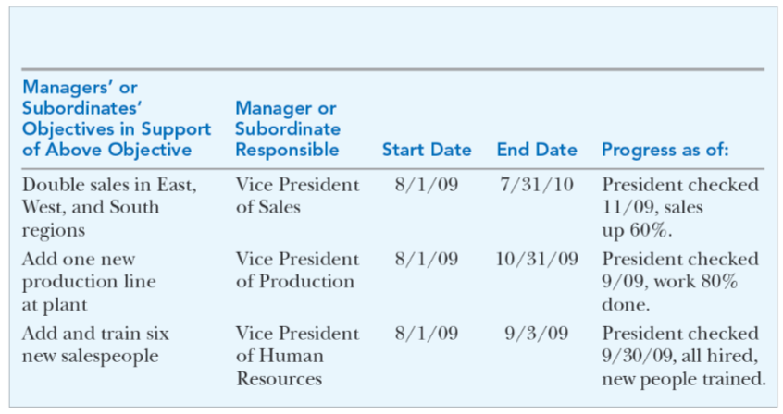
FIGURE 3–4 Management Objectives Grid
Company-Wide or Departmental Objective:
Double sales revenue to $16 million in fiscal year 2011
Copyright © 2011 Pearson Education, Inc. publishing as Prentice Hall
3–37
Notes:
The management objectives grid in Figure 3-4 spells out each department manager’s assigned goals in support of achieving the firm’s overall goals. In this case, one long-term top management goal is to “Double sales revenue to $16 million in fiscal year 2011.” The grid summarizes the goals each department must achieve if the firm is to meet its overall $16 million sales goal.
Managers use the management objectives grid:
To show each of your department manager’s goals and to list their supporting goals.
To clarify what their own goals should be, given the firm’s goals.
To summarize for their subordinates what their goals are, in light of the department’s goals.
As a quick way to track subordinates’ progress using the grid’s start and end dates.

Slide 38
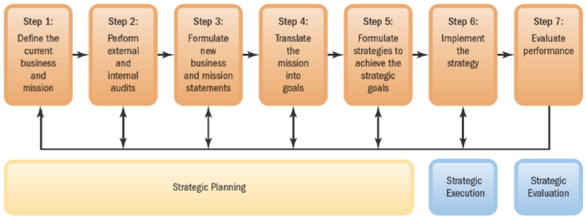
FIGURE 3–5 The Strategic Management Process
Copyright © 2011 Pearson Education, Inc. publishing as Prentice Hall
3–38
Notes:
The Strategic Management Process
Figure 3-5 sums up the strategic management process. This includes (1) defining the business and developing a mission, (2) evaluating the firm’s internal and external strengths, weaknesses, opportunities, and threats, (3) formulating a new business direction, (4) translating the mission into strategic goals, and (5) formulating strategies or courses of action. Step (6) and Step (7) entail implementing and then evaluating the strategic plan.

Slide 39
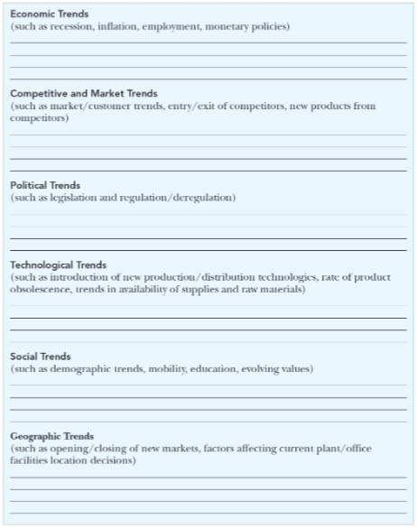
FIGURE 3–6 Worksheet for Environmental Scanning
Copyright © 2011 Pearson Education, Inc. publishing as Prentice Hall
3–39
Notes:
The environmental scanning worksheet in Figure 3-6 is a simple guide for compiling relevant information about the company’s environment. This includes things like economic, competitive, and political trends that have an effect on the company and its strategy for competing in its market.

Slide 40
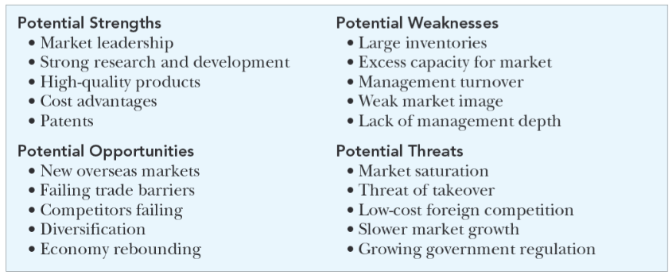
FIGURE 3–7 SWOT Matrix, with Generic Examples
Copyright © 2011 Pearson Education, Inc. publishing as Prentice Hall
3–40
Notes:
The SWOT chart in Figure 3-7 is used in strategic planning by managers to compile an estimate of the company strengths, weaknesses, opportunities, and threats when creating the firm’s strategy.
SWOT helps identify the factors that will allow a company to differentiate its product or service from those of its competitors to increase market share and gain a competitive advantage.

Slide 41
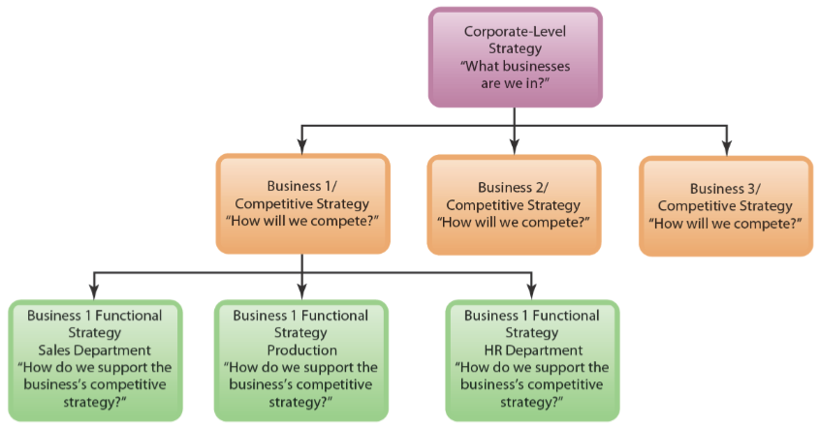
FIGURE 3–8 Type of Strategy at Each Company Level
Copyright © 2011 Pearson Education, Inc. publishing as Prentice Hall
3–41
Notes:
In Figure 3-8 we see the three types of strategies that managers use, one for each level of the company. There is corporate-wide strategic planning, business unit (or competitive) strategic planning, and functional (or departmental) strategic planning.

Slide 42
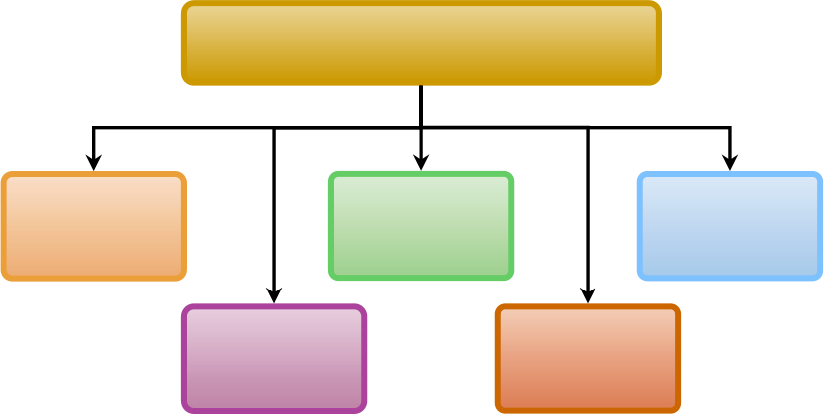
Types of Corporate Strategies
Corporate Strategy Possibilities
Concentration
Diversification
Consolidation
Vertical integration
Geographic expansion
Copyright © 2011 Pearson Education, Inc. publishing as Prentice Hall
3–42
Notes:
With a concentration (single business) strategy, the firm offers one product or product line, usually in one market. Concentration growth strategies include market penetration, product development, and horizontal integration.
A related diversification strategy implies that the firm will expand by adding new product lines and diversifying so that a firm’s lines of business still possess some kind of fit.
A conglomerate (unrelated) diversification strategy means diversifying into products or markets not related to a firm’s current businesses or to one another.
A vertical integration strategy means the firm expands by, perhaps, producing its own raw materials, or selling its products direct.
A consolidation strategy focuses on reducing a firm’s size.
Geographic expansion is taking the business abroad.

Slide 43
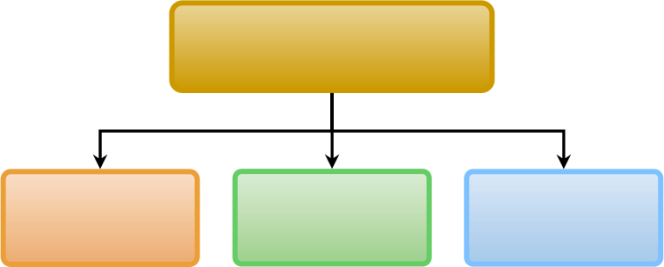
Types of Competitive Strategies
Business-Level
Competitive Strategies
Cost leadership
Differentiation
Focus/Niche
Copyright © 2011 Pearson Education, Inc. publishing as Prentice Hall
3–43
Notes:
Cost leadership means that a firm is seeking to become the overall low-cost leader in an industry.
Firms using a differentiation strategy seek to be unique in their industry along competitive dimensions that are widely valued by buyers.
Focusers are firms that attempt to compete in a narrow market segment (niche) through the provision of a product or service that specify customers can get in no other way.

Slide 44
Achieving Strategic Fit
  The “Fit” Point of View (Porter)
    All of the firm’s activities must be tailored to or fit the chosen strategy such that the firm’s functional strategies support its corporate and competitive strategies.
  Leveraging (Hamel and Prahalad)
    “Stretch” in leveraging resources—supplementing what you have and doing more with what you have—can be more important than just fitting the strategic plan to current resources.
Copyright © 2011 Pearson Education, Inc. publishing as Prentice Hall
3–44

Slide 45
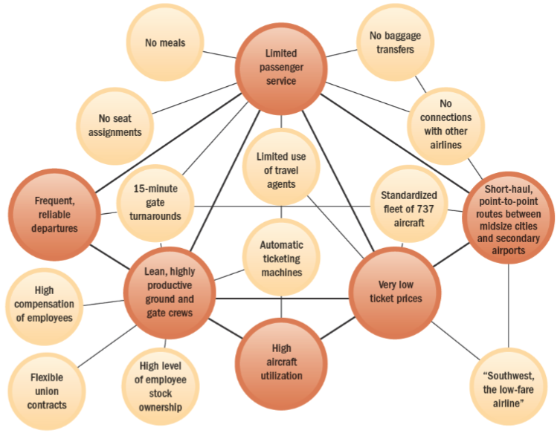
FIGURE 3–9 Southwest Airlines’ Activity System
Copyright © 2011 Pearson Education, Inc. publishing as Prentice Hall
3–45
Notes:
Figure 3-9 graphically illustrates how Southwest Airlines’ activities fit the firm’s low-cost strategy. The larger (pink) circles represent the pivotal aims that support Southwest’s low-cost system. These pivotal aims include limited passenger services and frequent reliable departures. Southwest’s departments each must support these aims. For example, “limited passenger service” means no seat assignments. “Highly productive ground crews” means high compensation, flexible union contracts, and employee stock ownership, or in summary:
High Pay > Highly Productive Ground Crews > Frequent Departures > Low Costs

Slide 46

Departmental Managers’
Strategic Planning Roles
Department Managers and Strategy Planning
Formulate supporting, functional/ departmental strategies
Help devise
the strategic plan
Execute
the strategic plans
Copyright © 2011 Pearson Education, Inc. publishing as Prentice Hall
3–46
Notes:
Departmental managers can play big roles in strategic planning and management. Specifically, they help the top managers devise the strategic plan, formulate functional, departmental plans that support the overall strategic plan, and then execute the plans.

Slide 47
Strategic Human Resource Management
  Strategic Human Resource Management
    The linking of HRM with strategic goals and objectives in order to improve business performance and develop organizational cultures that foster innovation and flexibility.
    Involves formulating and executing HR systems—HR policies and activities—that produce the employee competencies and behaviors that the company needs to achieve its strategic aims.
Copyright © 2011 Pearson Education, Inc. publishing as Prentice Hall
3–47

Slide 48
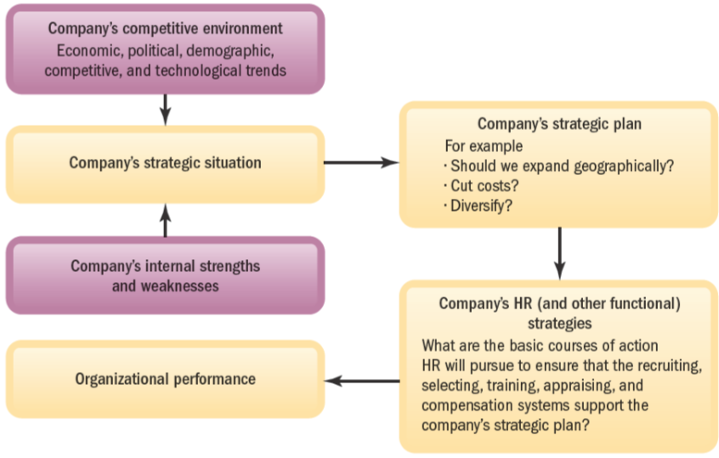
FIGURE 3–10 Linking Company-Wide and HR Strategies
Copyright © 2011 Pearson Education, Inc. publishing as Prentice Hall
3–48
Notes:
Figure 3-10 demonstrates the relationship between human resource strategy and the company’s strategic plans.

Slide 49
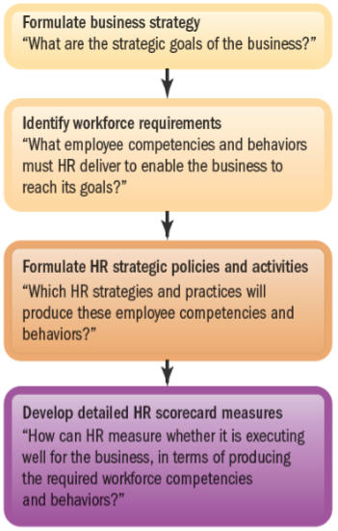
FIGURE 3–11 Basic Model of How to Align HR Strategy and Actions with Business Strategy
Copyright © 2011 Pearson Education, Inc. publishing as Prentice Hall
3–49
Notes:
Figure 3-11 outlines the basic idea behind strategic human resource management: In formulating human resource management policies and activities, the manager’s aim must be to produce the employee skills and behaviors that the company needs to achieve its strategic aims.
Management formulates a strategic plan that implies certain workforce requirements. Given these requirements, human resource management formulates HR strategies (policies and practices) to produce the desired workforce skills, competencies, and behaviors.
Finally, the human resource manager identifies the measures he or she can use to gauge the extent to which its new policies and practices are actually producing the required employee skills and behaviors.

Slide 50
Strategic HRM Tools
Strategic HRM Tools
Strategy map
HR scorecard
Digital dashboard
Copyright © 2011 Pearson Education, Inc. publishing as Prentice Hall
3–50
Notes:
Managers use several tools to help them translate the company’s broad strategic goals into specific human resource management policies and activities. Three important tools include the strategy map, the HR Scorecard, and the digital dashboard.

Slide 51
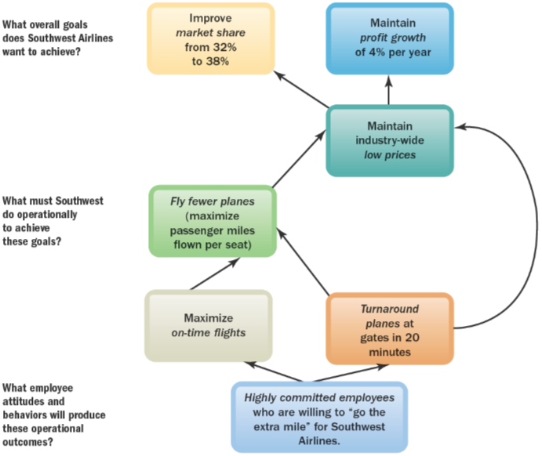
FIGURE 3–13 Strategy Map for Southwest Airlines
Copyright © 2011 Pearson Education, Inc. publishing as Prentice Hall
3–51
Notes:
The Strategy Map
A strategic planning tool that shows the “big picture” of how each department’s performance contributes to achieving the company’s overall strategic goals.
Figure 3-13 presents a strategy map example, in this case for Southwest Airlines. Southwest has a low-cost leader strategy. The strategy map for Southwest lays out the hierarchy of main activities required for Southwest Airlines to succeed.
At the top is achieving company-wide, strategic financial goals. Then the strategy map shows the chain of activities that help Southwest Airlines achieve its revenues and profitability goals. Southwest needs to fly fewer planes (to keep costs down), maintain low prices, and maintain on-time flights.
The strategy map helps each department (including HR) visualize what it needs to do to support Southwest’s low-cost strategy.

Slide 52
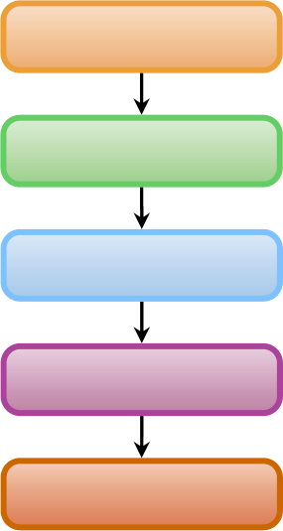
FIGURE 3–14 The Basic HR Scorecard Relationships
HR activities
Emergent employee behaviors
Strategically relevant organizational outcomes
Organizational performance
Achieve strategic goals
Copyright © 2011 Pearson Education, Inc. publishing as Prentice Hall
3–52
Notes:
The HR Scorecard
A process for assigning financial and nonfinancial goals or metrics to the human resource management–related chain of activities required for achieving the company’s strategic aims and for monitoring results. Figure 3-14 summarizes this process.
Managers use special scorecard software to facilitate this. The computerized scorecard process helps you to quantify the relationships between (1) the HR activities (amount of testing, training, and so forth), (2) the resulting employee behaviors (customer service, for instance), and (3) the resulting firm-wide strategic outcomes and performance (such as customer satisfaction and profitability).

Slide 53











Creating an HR Scorecard
The 10-Step HR Scorecard Process
1
Define the business strategy
6
Identify required HR policies and activities
2
Outline value chain activities
7
Create HR Scorecard
3
Outline a strategy map
8
Choose HR Scorecard measures
4
Identify strategically required outcomes
9
Summarize Scorecard measures on digital dashboard
Identify required workforce competencies and behaviors
10
5
Monitor, predict, evaluate
Copyright © 2011 Pearson Education, Inc. publishing as Prentice Hall
3–53

Slide 54

FIGURE 3–15 Three Important Strategic HR Tools
Strategy Map
HR Scorecard
Digital Dashboard
A graphical tool that summarizes the chain of activities that contribute to a company's success,
and so shows employees the "big picture" of how their performance
contributes to achieving the company's overall strategic goals.
A process for managing employee performance and for aligning all
employees with key objectives, by assigning financial and nonfinancial goals, monitoring and
assessing performance, and quickly taking corrective action.
An information technology tool that presents the manager with desktop graphs and charts, so he or she gets a picture of where the company has been and where it's going, in terms of each activity in the strategy map.
Copyright © 2011 Pearson Education, Inc. publishing as Prentice Hall
3–54
Notes:
Figure 3-15 summarizes the three important strategic HR tools.

Slide 55
Building A High-Performance Work System
  High-Performance Work System (HPWS)
    A set of human resource management policies and practices that promote organizational effectiveness.
  High-Performance Human Resource Policies
  and Practices
    Emphasize the use of relevant HR metrics.
    Set out the things that HR systems must do to become an HPWS.
    Foster practices that encourage employee self-management.
    Practice benchmarking to set goals and measure the notable performance differences required of an HPWS.
Copyright © 2011 Pearson Education, Inc. publishing as Prentice Hall
3–55
Notes:
High-performance work systems became popular in the 1990s. Faced with global competition, U.S. companies needed ways to improve quality, productivity, and responsiveness.
Characteristics of high-performance work organizations include multi-skilled work teams, empowered front-line workers, extensive training, labor-management cooperation, commitment to quality, and customer satisfaction.

Slide 56
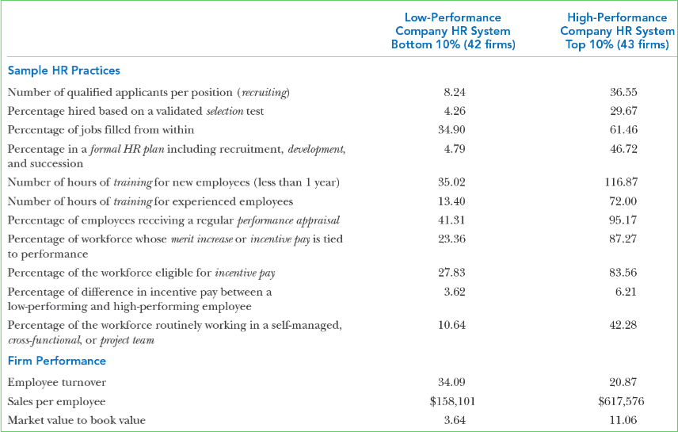
TABLE 3–1 Comparison of Selected Human Resource Practices in
High-Performance and Low-Performance Companies
Copyright © 2011 Pearson Education, Inc. publishing as Prentice Hall
3–56
Notes:
That a human resource manager can influence things like “number of qualified applicants per position” and “percentage of jobs filled from within” is apparent. After all, those are the sorts of activities that human resource managers oversee.
Every department manager and supervisor can also play an important role in activities like these and thus build, within his or her own departmental domain, a higher performing organization.
Table 3-1 provides a road map for doing so.

Slide 57
K E Y T E R M S
business plan
management by objectives (MBO)
strategic plan
strategy
strategic management
vision statement
mission statement
corporate-level strategy
competitive strategy
competitive advantage
functional strategies
offshoring
strategic human resource
management
strategy map
HR Scorecard
digital dashboard
high-performance work system
human resource metric
value chain
HR audit
Copyright © 2011 Pearson Education, Inc. publishing as Prentice Hall
3–57

Slide 58
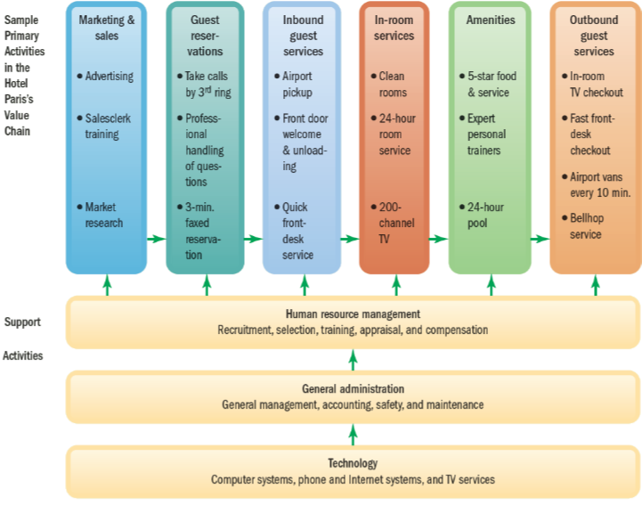
FIGURE 3–16 Simple Value Chain for “The Hotel Paris”
Copyright © 2011 Pearson Education, Inc. publishing as Prentice Hall
3–58

Slide 59
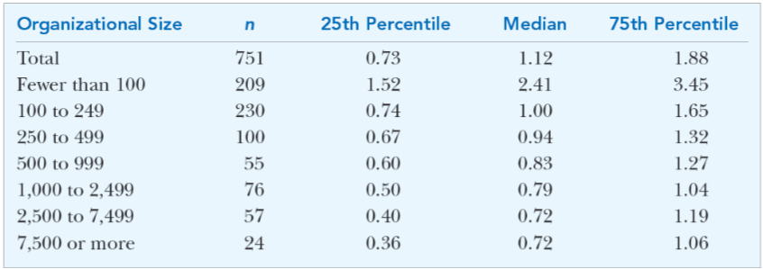
FIGURE 3A-1 Simple Value Chain for “The Hotel Paris”
Copyright © 2011 Pearson Education, Inc. publishing as Prentice Hall
3–59

Slide 60
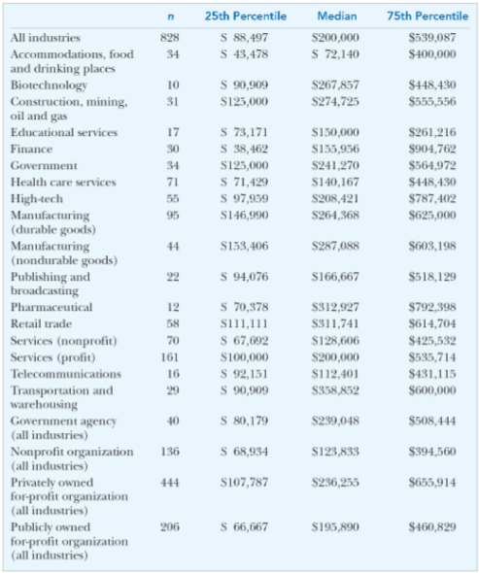
FIGURE 3A-2 Revenue per FTE (by Industry)
Copyright © 2011 Pearson Education, Inc. publishing as Prentice Hall
3–60

Slide 61
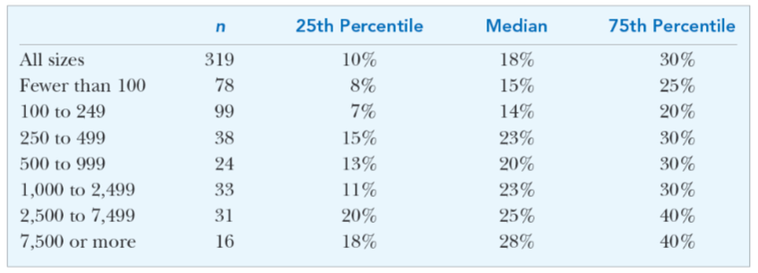
FIGURE 3A-3 2007 Target Bonus Percentage for Executives
(Percent of Total Compensation, by Organizational Size)
Copyright © 2011 Pearson Education, Inc. publishing as Prentice Hall
3–61

Slide 62
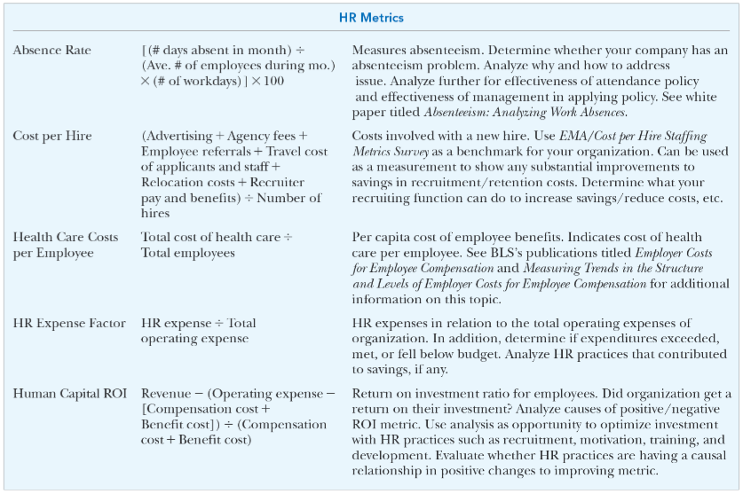
FIGURE 3A-4 Sample Metrics from SHRM Measurements Library
Copyright © 2011 Pearson Education, Inc. publishing as Prentice Hall
3–62

Slide 63
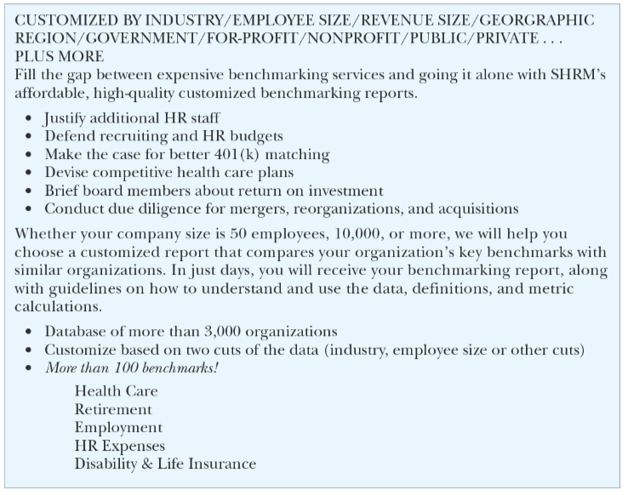
FIGURE 3A-5 Highlights of SHRM® Customized Benchmarking Service
Copyright © 2011 Pearson Education, Inc. publishing as Prentice Hall
3–63

Slide 64
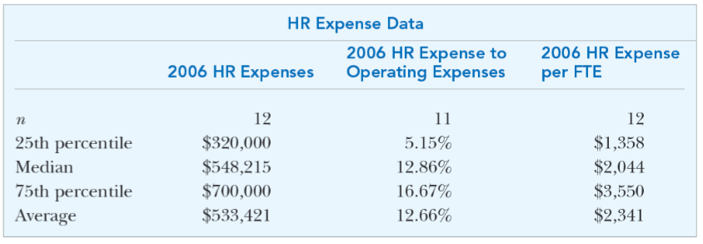
FIGURE 3A-6 Customized Human Capital Benchmarking Report
for [Your Organization’s Name Here]
Copyright © 2011 Pearson Education, Inc. publishing as Prentice Hall
3–64

Slide 65
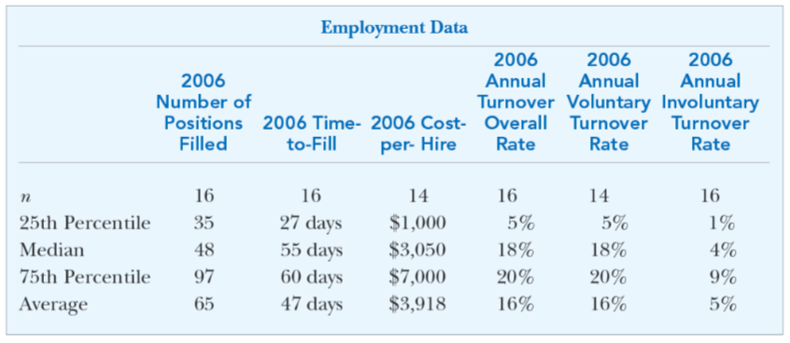
FIGURE 3A-7 Customized Human Capital Benchmarking Report
for [Your Organization’s Name Here]
Copyright © 2011 Pearson Education, Inc. publishing as Prentice Hall
3–65

Slide 66
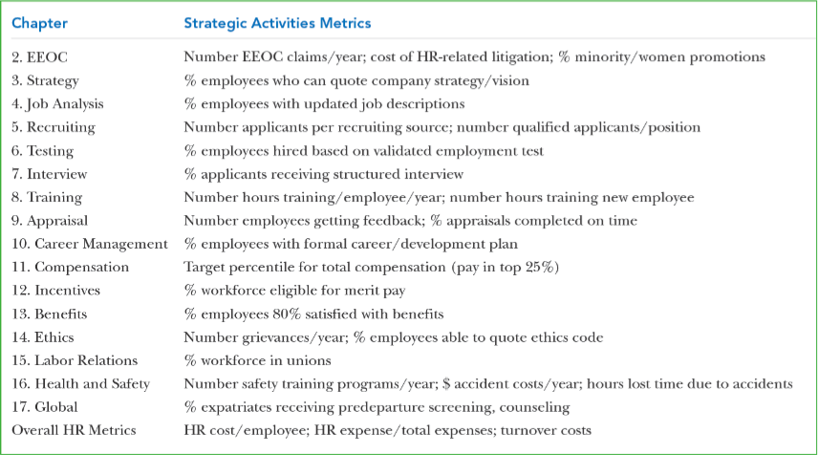
TABLE 3–2 Examples of HR System Activities the Hotel Paris Can
Measure as Related to Each Chapter in This Book
Copyright © 2011 Pearson Education, Inc. publishing as Prentice Hall
3–66

